Slide 1
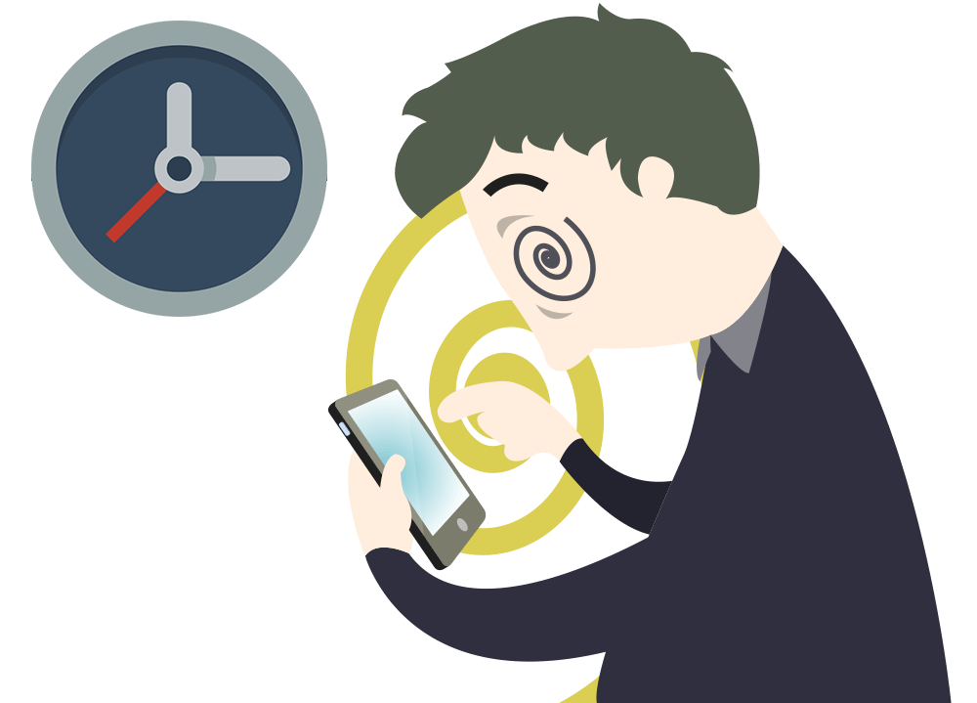
Side effects of mobile phone use!
Dr Prannay Gulati
MBBS, MD (Psychiatry)
Ex PGI,Chd; Ex GMCH-32, Chd
Consultant Psychiatrist
Indus International Hospital

Slide 2
Uses of mobile phones
Communication
Small and Convenient
Photos and Video
Texting
Fashion and Self-Expression
Entertainment
Notes and Reminders
Video in Real Time
Calendars and Organization
Maps, Navigation, and Travel
Learning and Research
Online Banking and Finance
Address Book and Contacts
Remote Working
Emergencies
Watches and Alarm Clocks
Calculator
Flashlight/Torch
News, Sports, and Live Events
Crime Prevention and Evidence Gathering

Slide 3
Phantom Pocket Vibration Syndrome

Slide 4
Blurred Vision

Slide 5
Brain Cancer Risk

Slide 6
Sleep Disorders

Slide 7
Neck and Back Pain

Slide 8
Accidents

Slide 9
Increases Anxiety

Slide 10
Cyber Bullying

Slide 11
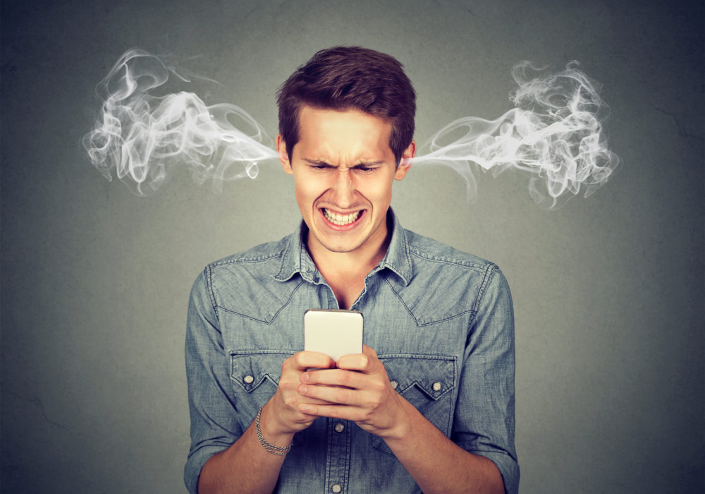
Stress

Slide 12
Phone Addiction

